Slide 1
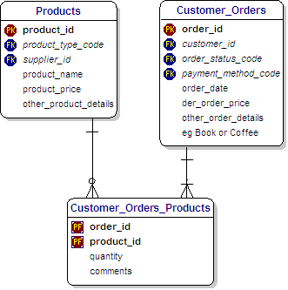
Keys
◦ Primary
◦ Foreign Keys
Relationships
◦ One-to-Many
◦ Many-to-Many Relationships

Slide 2
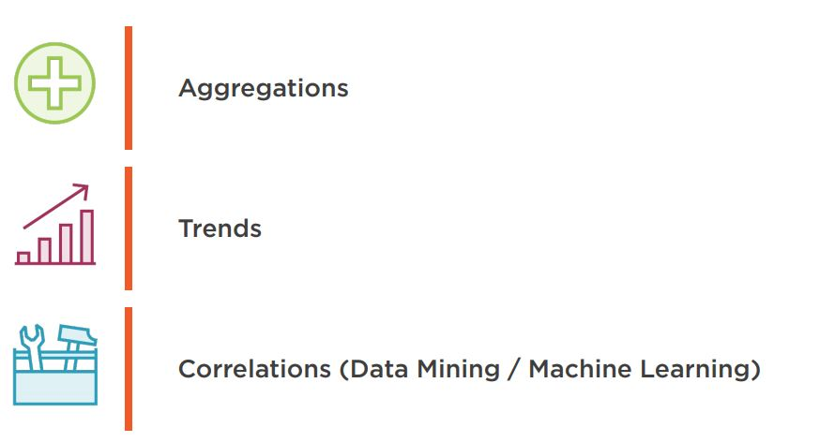
Areas of Interest

Slide 3
Star Schema
Dimension
Dimension
Dimension
Fact Table
Dimension
Dimension
Dimension

Slide 4
DimProductSubCategory
DimDate
DimProduct
FactInternetSales
DimSalesTerritory
DimPromotion
Data Model

Slide 5
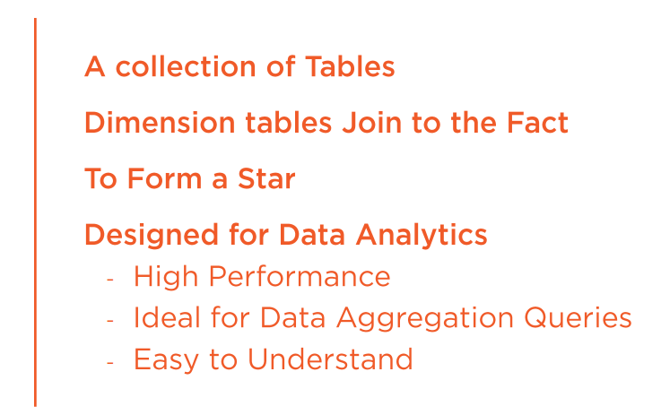
Star Data Model

Slide 6
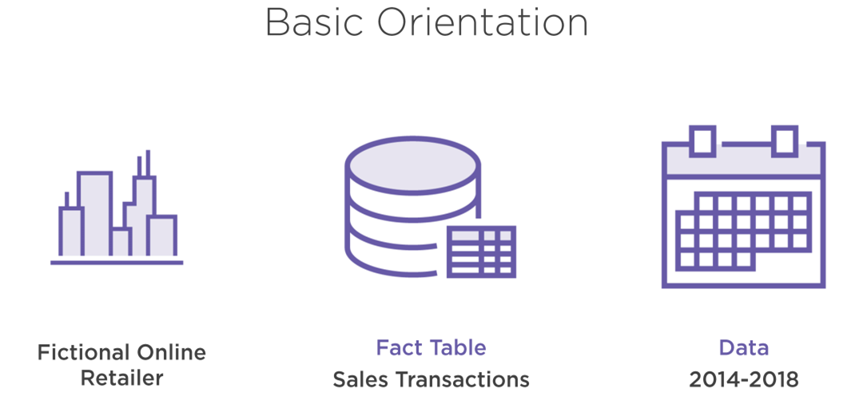

Slide 7
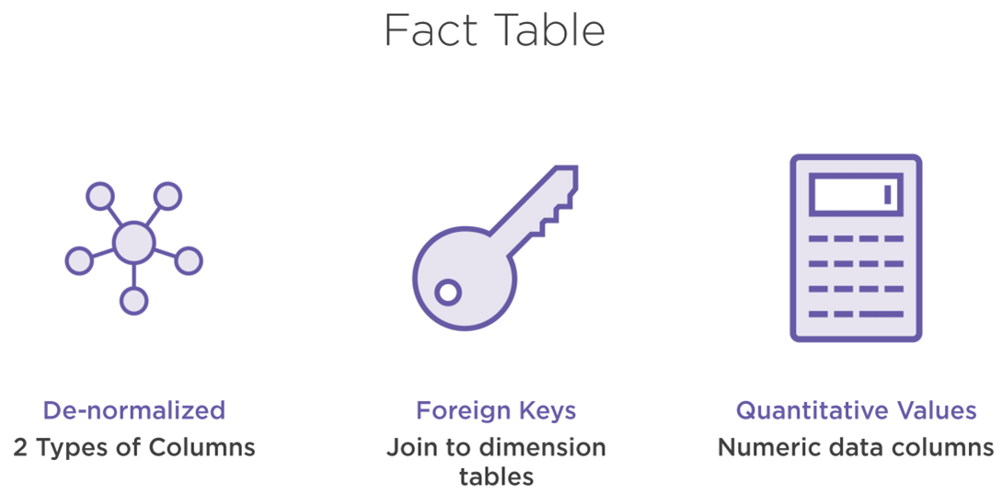

Slide 8
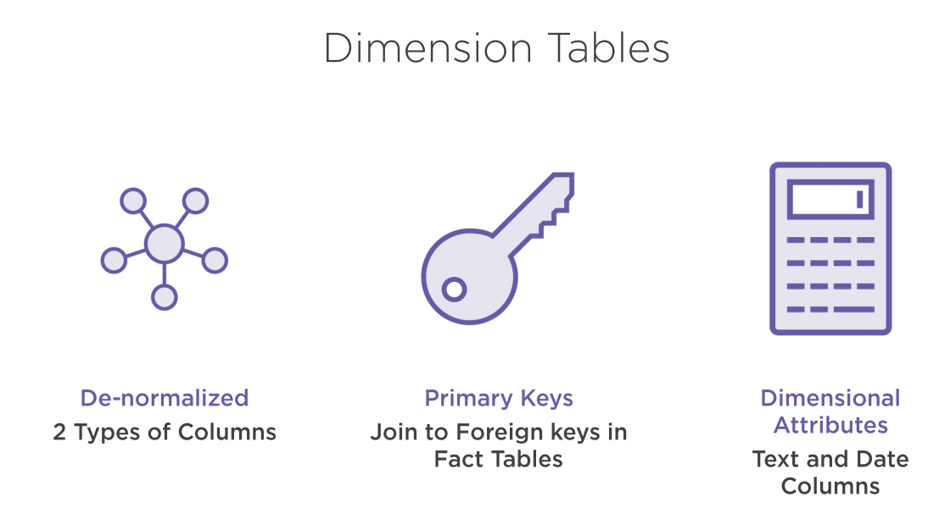

Slide 9
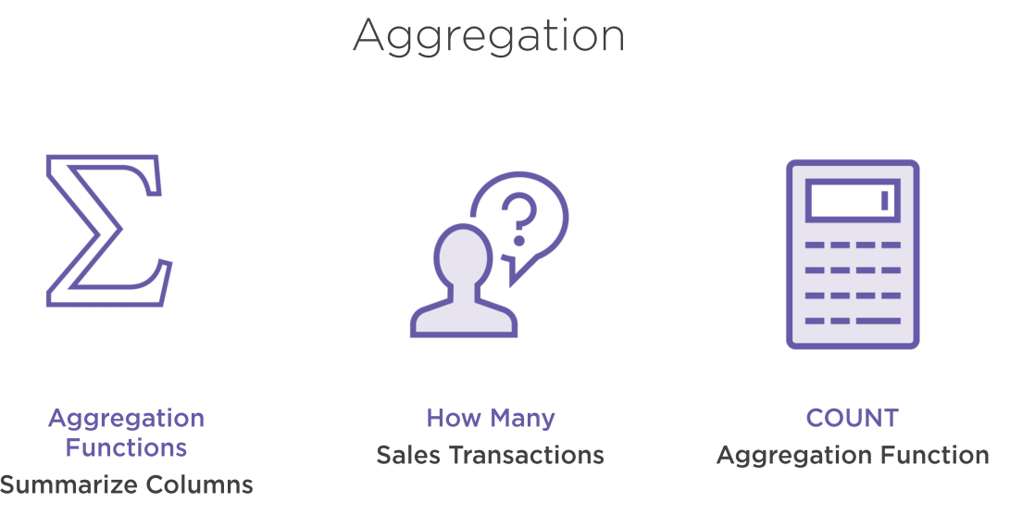

Slide 10
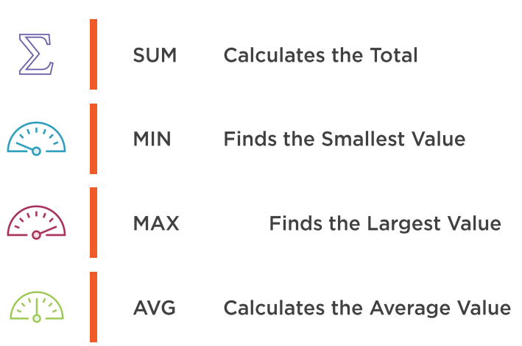
Aggregation Functions

Slide 11
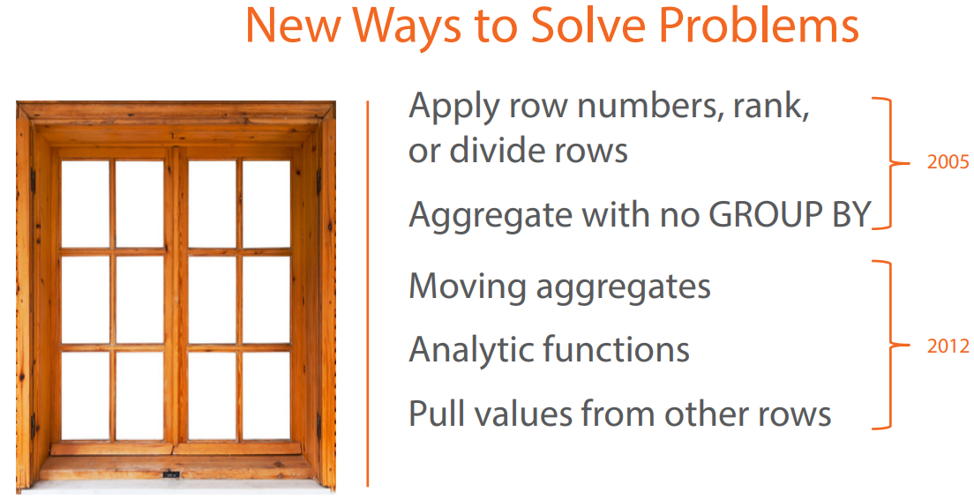

Slide 12
Real World Examples
Stock Market Problem
The Islands Problem
First N Problem
Deduplication
Gold Star Problem

Slide 13
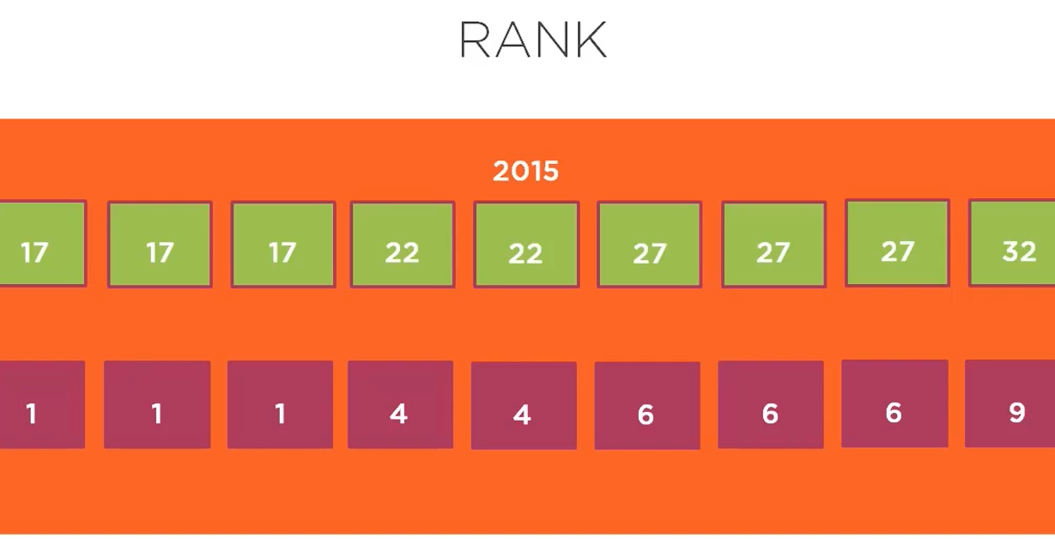

Slide 14
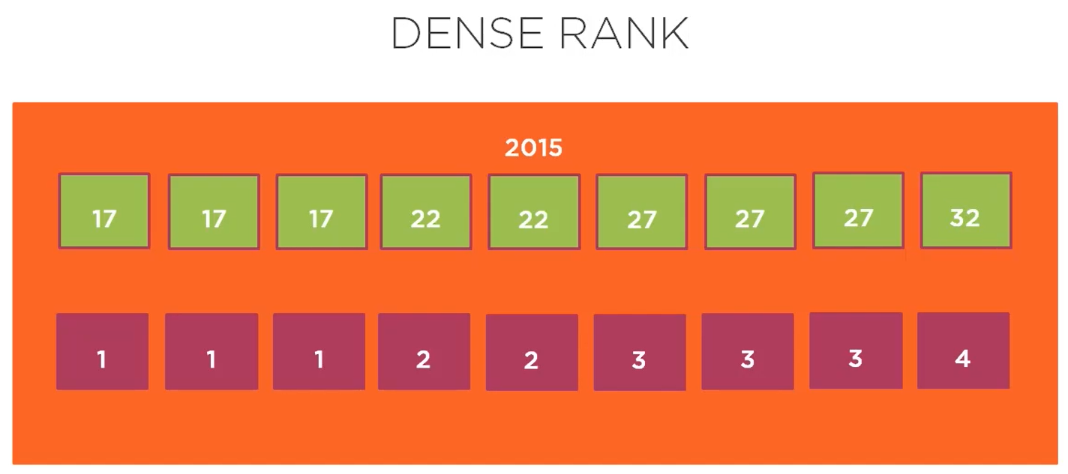

Slide 15
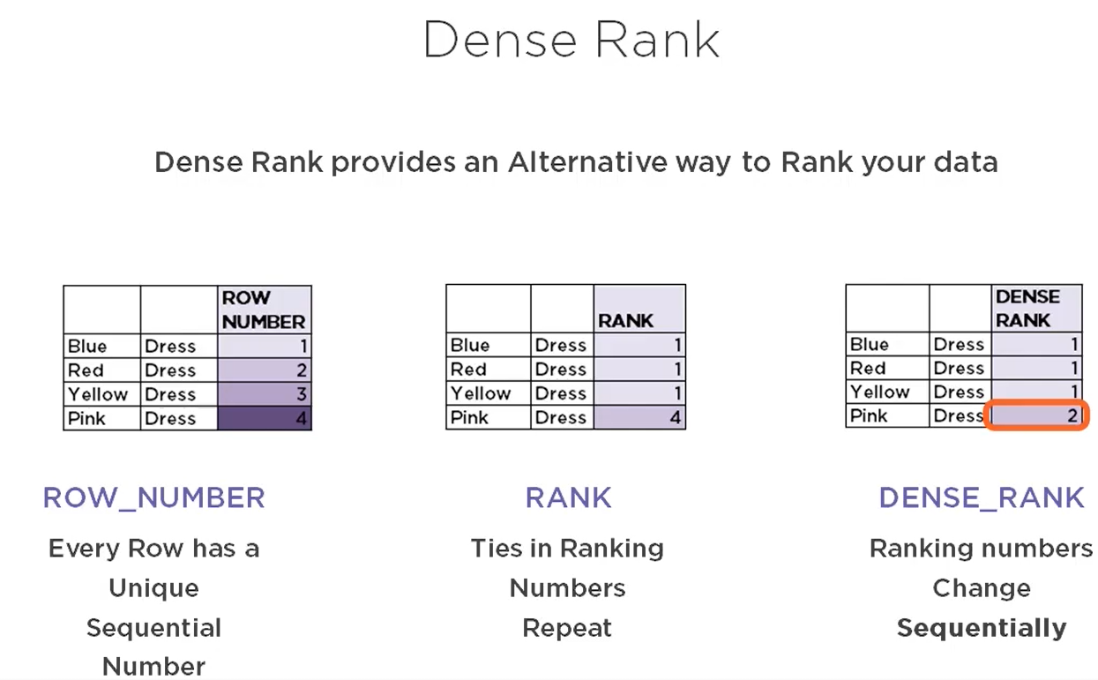

Slide 16
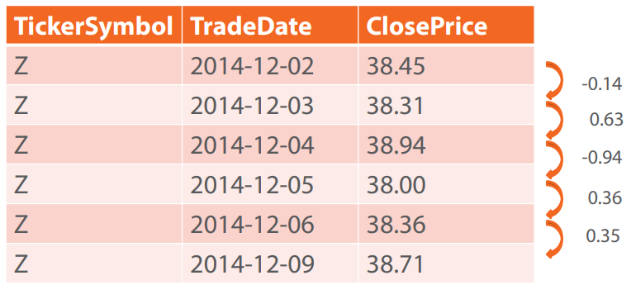
Stock Market Problem

Slide 17
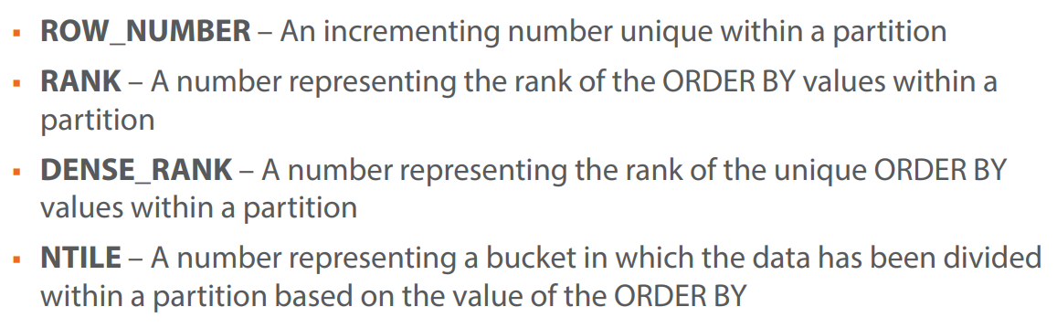
Ranking Functions

Slide 18
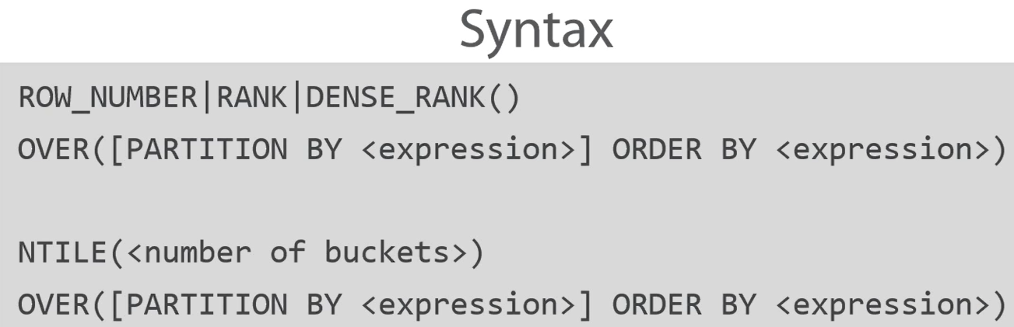

Slide 19
Real World Examples
Stock Market Problem
The Islands Problem
First N Problem
Deduplication
Gold Star Problem

Slide 20
The gaps and islands problem is about finding gaps in sequences or about finding ranges of consecutive values (the islands)
How long and how frequent has someone logged into a website (island problem)?
What were the sick days of a person and did the number of sick days over a period of time surpassed some value so that it is now extended sick leave (also an island problem)?
How often did the server go offline (gaps problem)? When did the student not attend the classes (gaps problem)?
All the problems are related to each other, as finding gaps is the inverse of finding islands.

Slide 21
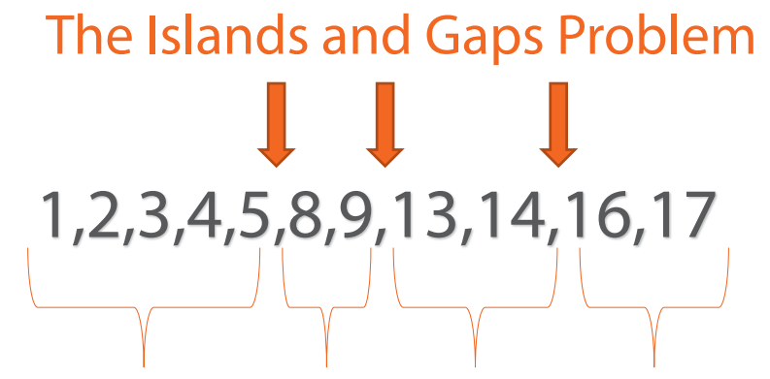

Slide 22
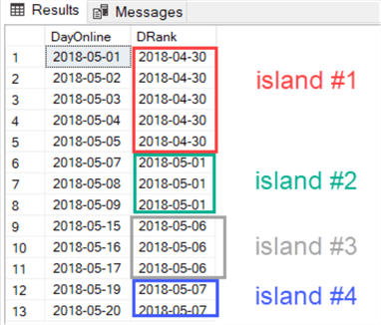

Slide 23
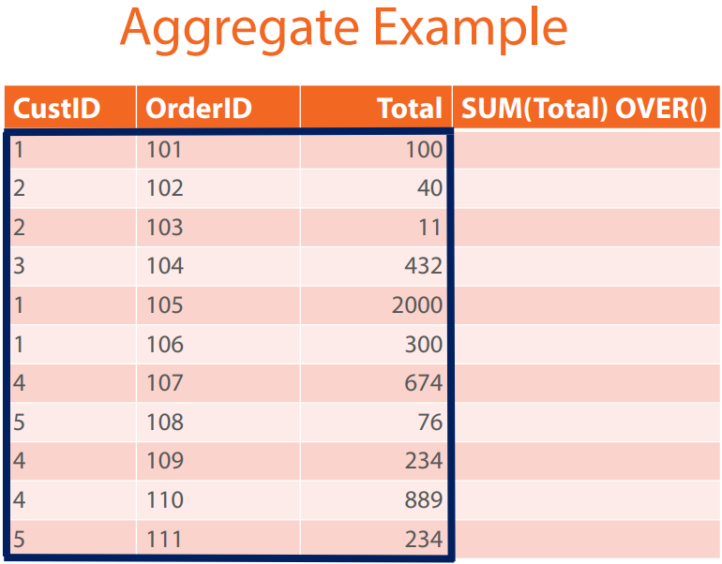

Slide 24
